Slide 1

G & V Value functions
Benny Bornfeld

Slide 2




G – Sum of future discounted returns
$G_{π\left(t\right)}=R_{\left(t+1\right)}+γ$ $R_{\left(t+2\right)}$ $+γ^{2}$ $R_{\left(t+3\right)}$ $+γ^{3}$ $R_{\left(t+4\right)}+…Until Terminal State$
S4
S3
S2
S1
R = 0
R = 0
R = 0
R = 100
$$γ=0.9$$
$G_{\left(s4\right)}=$ 81
$G_{\left(s3\right)}=$ 90
$G_{\left(s2\right)}=$ 100
$G_{\left(s1\right)}=$ 0, Terminal state yields no further rewards

Slide 3

G – Sum of future discounted returns
$G_{π\left(t\right)}=R_{\left(t+1\right)}+γ$ $R_{\left(t+2\right)}$ $+γ^{2}$ $R_{\left(t+3\right)}$ $+γ^{3}$ $R_{\left(t+4\right)}+…Until Terminal State$
S5
S6
R = -10
R = 10
S4
S3
S2
S1
R = 0
R = 0
R = 0
R = 100
$$γ=0.5$$
$G_{\left(s6\right)}=$ ?, $G_{\left(s5\right)}=$ ? , $G_{\left(s4\right)}=$ ?

Slide 4
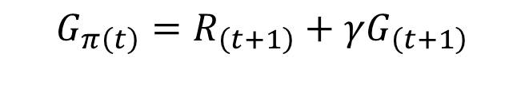
Rewriting G in a recursive manner
$G_{π\left(t\right)}=R_{\left(t+1\right)}+γ$ $R_{\left(t+2\right)}$ $+γ^{2}$ $R_{\left(t+3\right)}$ $+γ^{3}$ $R_{\left(t+4\right)}+…Until Terminal State$
$G_{π\left(t\right)}=R_{\left(t+1\right)}+γ$ ($R_{\left(t+2\right)}$ $+γ^{}$ $R_{\left(t+3\right)}$ $+γ^{2}$ $R_{\left(t+4\right)}+…Until Terminal State)$
$$G_{π\left(t\right)}=R_{\left(t+1\right)}+γG_{\left(t+1\right)}$$

Slide 5





Welcome to GridWorld
$$γ=0.9$$
Actions
R = +1
$G=$ 0
R = -1
What are the G values according to the given policy?

Slide 6









Welcome to GridWorld
$$γ=0.9$$
Actions
R = +1
$G=$ 0.81
$G=$ 0.9
$G=$ 1
$G=$ 0
R = -1
$G=$ 0.729
$G=$ 0.9
$G=$ 0.6561
$G=$ 0.729
$G=$ 0.81
$G=$ 0.729

Slide 7


Non Optimal Policy
$$γ=0.9$$
Actions
R = +1
$G=$ 1
$G=$ 0
R = -1
$G$ ?
$G=$ 0.9
$G=$ 0.6561
$G=$ 0.729
$G=$ 0.81

Slide 8
Illegal Moves
Actions
R = +1
$G=$ 0
R = -1
With illegal moves you return to the current state, but you lost 1 turn

Slide 9
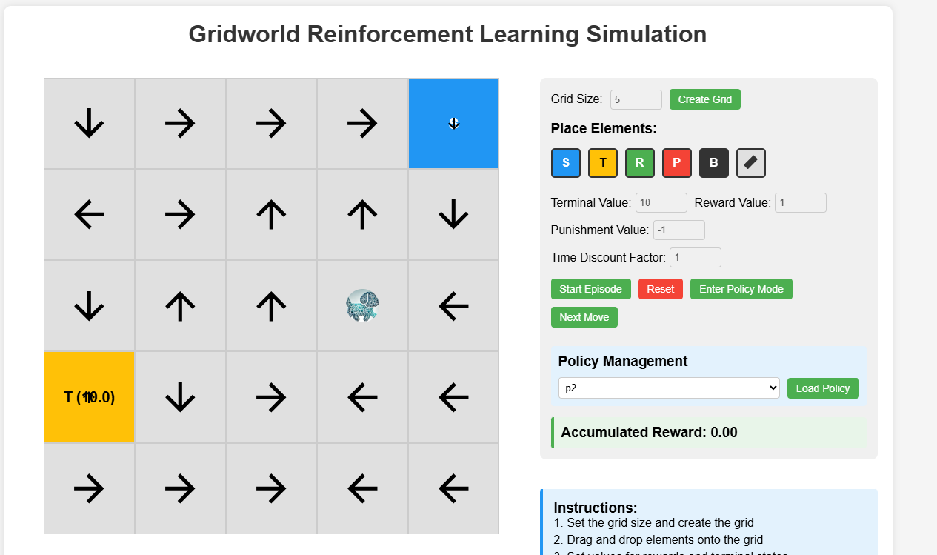
https://websim.com/@snowyfield91121232/gridworld-reinforcement-learning-simulation-2

